Slide 1
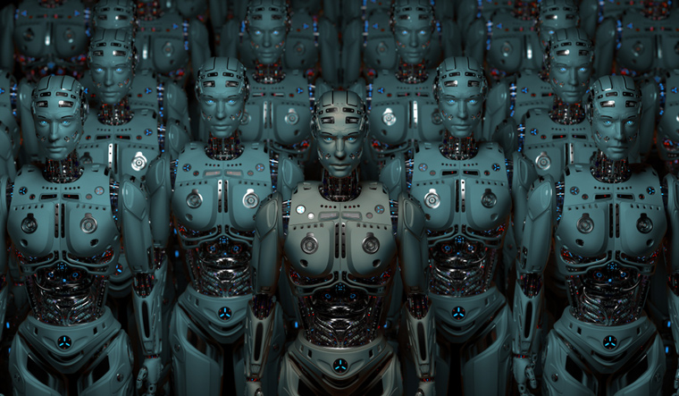
AI Pathfinding algorithms: why you should never put my in charge of anything ever.
Really.

Slide 2
THE PLAN.
Define the neurons.
Determine reward and punishment amounts.
Add physics.
Add teammates
Run the robot to the goal for a given field and teammate paths.
Mark each square through which the robot drove according to the reward/penalty.
Got to p.6 unless enough trials.
Save the path with the best score of tiles.
Go to part 5 with different teammates

Slide 3
How events unfolded.
Day One
Follow an ai course I had bought and never got around to taking. Finding a old piece of code from Berkeley.
Days Two to Four
Day Four
Finally realize that the code is literally a test for college students and is wildly unfinished.
Work on that code.
Day Five
Work on a completely new code base.

Slide 4
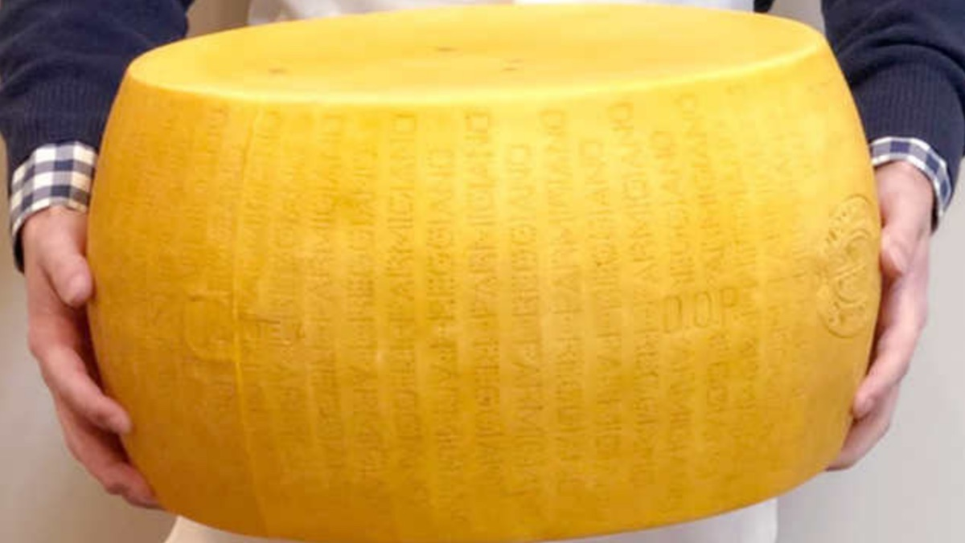
What we bit off.

Slide 5
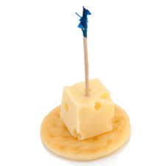
What we could chew.

Slide 6
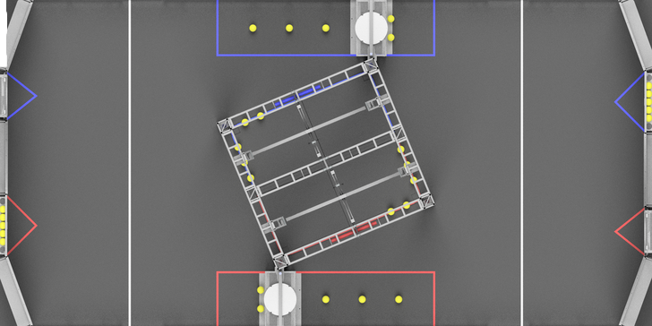
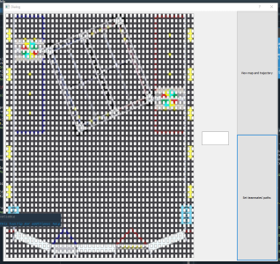
Cool things that worked.
I converted this into code,
And we made this great GUI.

Slide 7
Things we learned.
I learned a chunk of python, Grisha learned python, Noah probably learned python but has disappeared at time of writing.
Me and Noah both learned the principles of Q learning, and deep learning.
Grisha found a new favorite code editor. (spyder/anaconda).
And I learned how to make a powerpoint.

Slide 8
Epilogue.
The plan is to continue the project, hopefully get something useful out of it. The current hold up is a math error.

